Slide 1

JYOTHY INSTITUTE OF TECHNOLOGY Tataguni, Bangalore-82 Department of Information Science &Engineering Accredited by National Board of Accreditation(NBA)-New Delhi
DBMS MINI PROJECT REVIEW-1(18CSL58)
TITLE: INVENTORY MANAGEMENT SYSTEM
Presented By: Under the Guidance:
Shreesha R (USN-1JT21IS047) Prof. Anupama V.P
Sarthak (USN-1JT2IS044)

Slide 2
INSTITUTION VISION & MISSION
Vision of the Institution :
To be an institution of excellence in Engineering education, Innovation and Research and work towards evolving great leaders for the country’s future and meeting global needs.
Mission of the Institution :
The Institution aims at providing a vibrant, intellectually and emotionally rich teaching learning environment with state of art infrastructure and recognizing and nurturing the potential of each individual to evolve into one’s own self and contribute to the welfare of all.

Slide 3
Information Science and Engineering VISION AND MISSION
Vision of the Department:
To be a Department of excellence for education in Information Science and Engineering, innovation, research and work towards empowering students for professional competence and entrepreneurial skills. Mission of the Department:
M1: To provide state of the art infrastructure with modern and innovative teaching methodology.
M2: To encourage and nurture collaborative and interdisciplinary projects that aid academic and industrial research.
M3: To promote activities to inculcate ethical practices and entrepreneurial skills.

Slide 4
USER SPECIFICATION REQUIREMENT
A standalone software system that facilitates the maintanence, updation and monitoring of goods in a physical facility.
Simple user interface with integrated database with backup on local systems.
Suitable for medium scale business with less complex operations.

Slide 5
MOTIVATION
Inventory Management System is a software that enables organizations involved in the buying and selling of goods to operate smoothly.
Having exposure to python and its tkinter library which is used develop GUI based desktop applications has enabled us to choose this project.

Slide 6
PROBLEM STATEMENT
To develop a standalone system for the constant monitoring of movement of goods in and out of a facility with simple user interface and designation based authentication system.

Slide 7
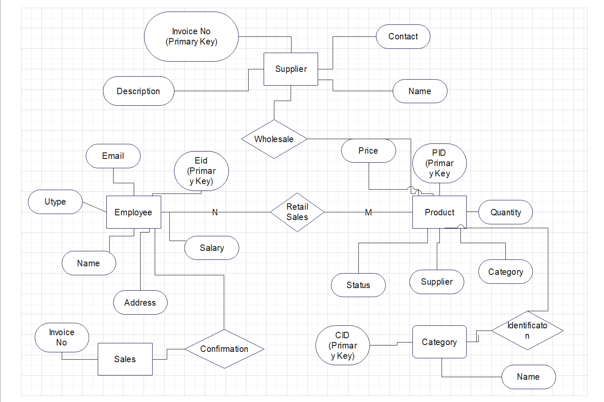
ENTITY ELATIONSHIP DIAGRAM

Slide 8
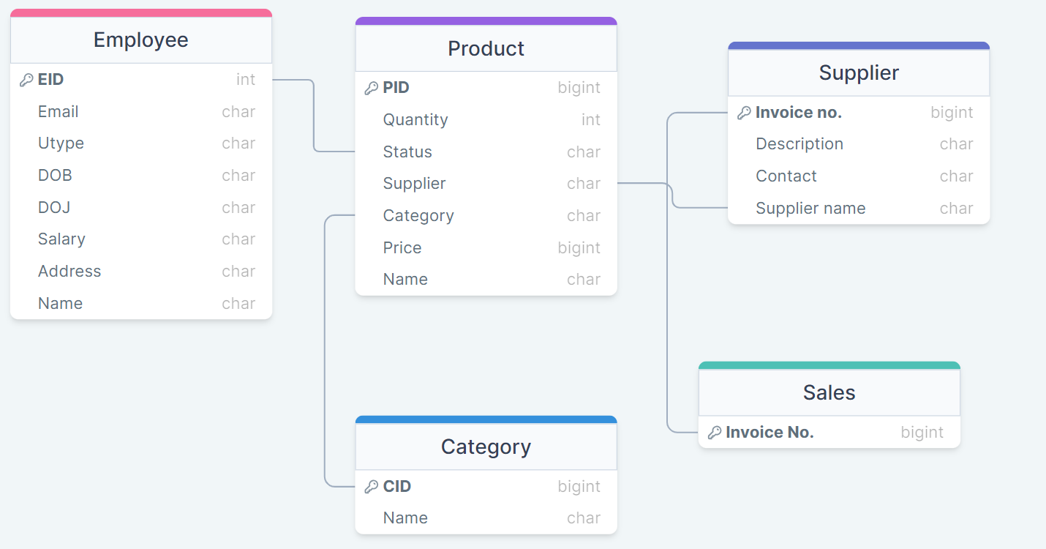
SCHEMA DIAGRAM

Slide 9
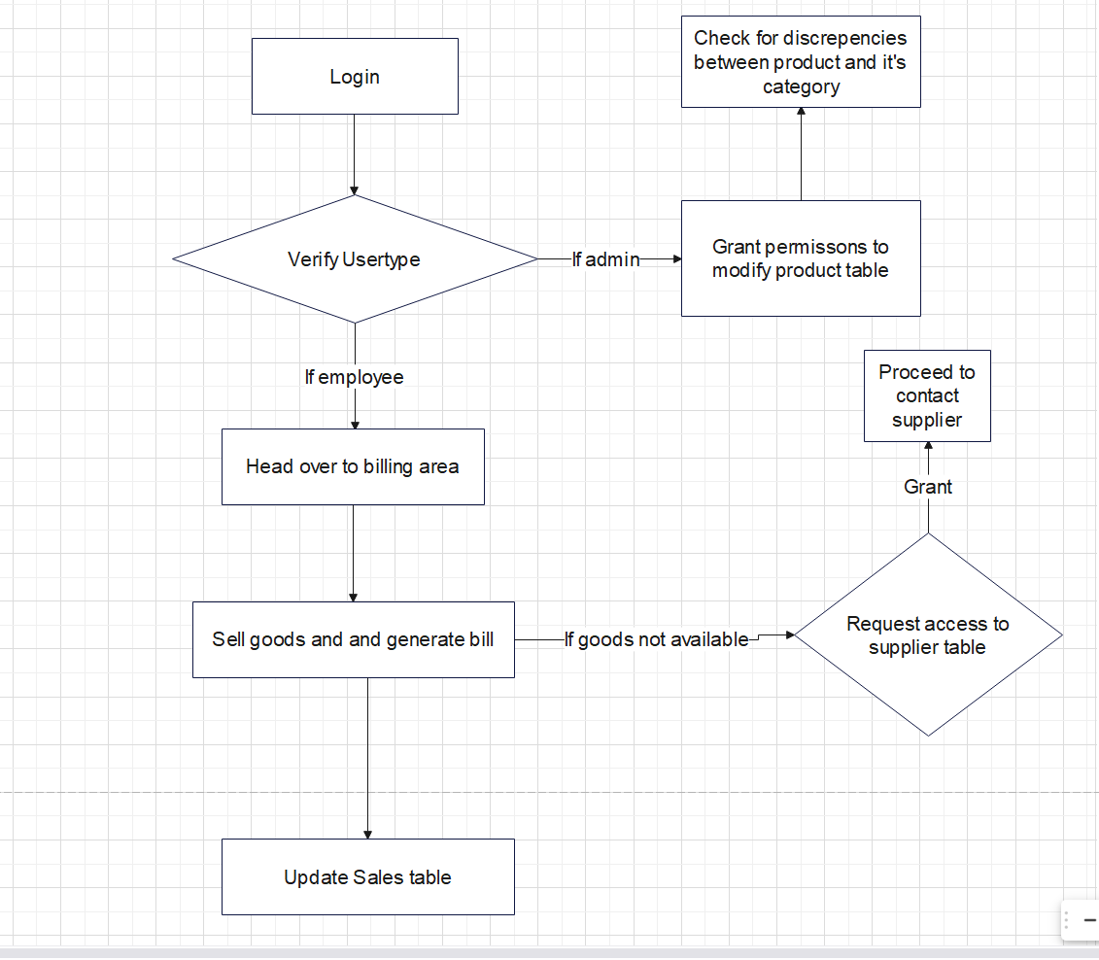
DATA FLOW DIAGRAM

Slide 10
SYSTEM SPECIFICATION REQUIREMENTS
Hardware Requirements:
A Personal Computer( PC ) or a laptop or workstation preferably 64 bit with requisite storage and a minimum of 4GB RAM
Operating Systems: Windows, Mac, Linux
Software Requirements:
Python Interpreter (available from the official site of python)

Slide 11
THANKYOU

